Slide 1
Employee Development & Retention Programme under National Dual Training System (NDTS)

Slide 2
Apprenticeship Programme for existing staff
Theory and practical (hands-on)
On the job training in factory/workplace

Slide 3
Programme Objective & Benefits
Skilled Scholarship
(up to Advance Diploma or Micro Credentials)
Increases Retention
RM500 Allowances
/month/trainee
Upskill and Reskill
Dual Language English/Bahasa Malaysia
Flexible Training Arrangement

Slide 4
Programme Information
Duration
1st month | 2nd month | 3rd month | 4th month | 5th month | 6th month
Up to 6 months
Depend on the NOSS
Skilled Deficit / Skilled Absence
Weekly
The OJT portion of the company is done at MIT if there is a Skill Deficit & Skill Absence
For example, the company ABC Manufacturing, have a total of 5 CUs’ for Mechatronic
2 CUs’ + 3 CUs training skilled deficit and skilled absence
Fully self-paced learning via LMS

Slide 5
Asynchronous
(Self-paced learning)
Mode of
training
Synchronous
(2x Zoom / MSTeam)
* 4hrs + 4hrs *
or joined the recorded
sessions
On The Job Training
Classroom is done
twice a month for technical
Training programme
(Full day)
Face to face
(Physical)

Slide 6
Programme Information
C. Allowances Breakdown by Monthly
RM 500
RM 300
RM 200
Trainee
Training provider
Company
RM 1 000

Slide 7
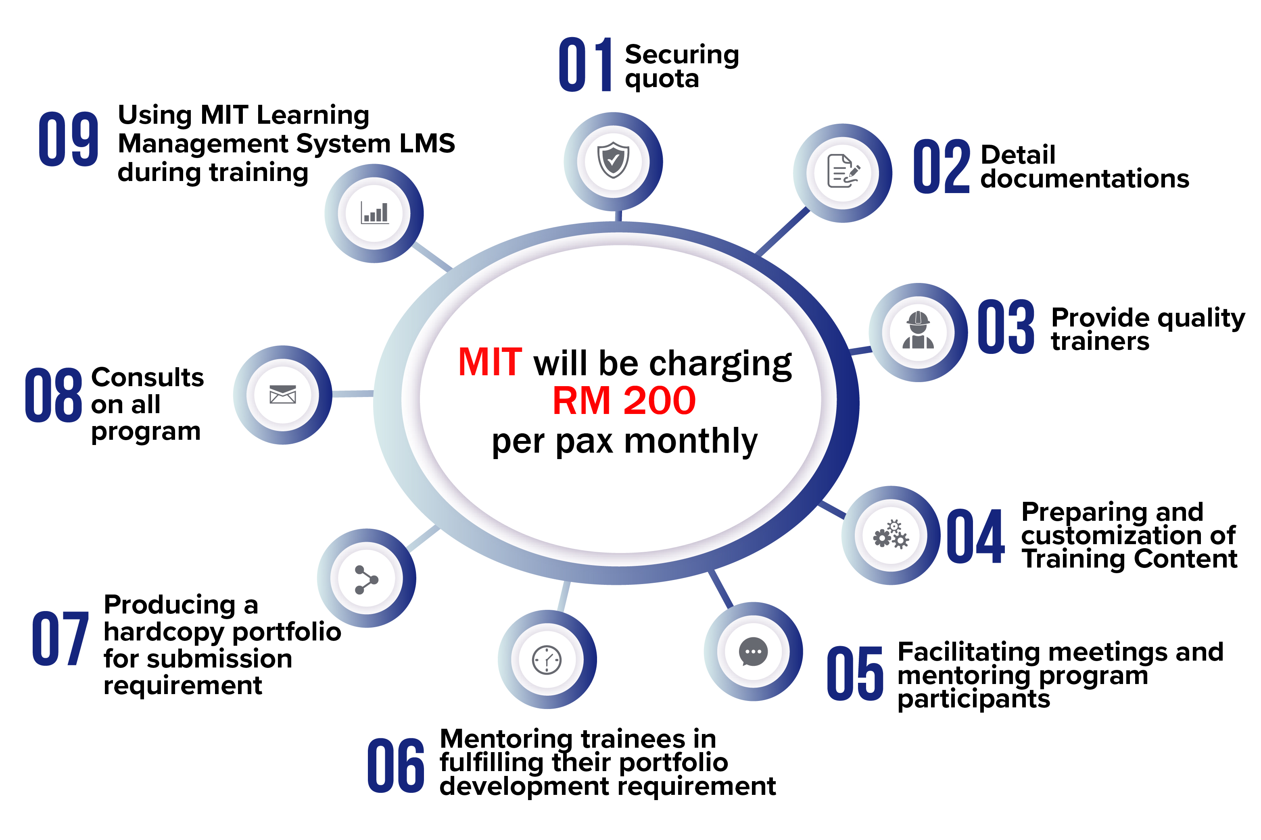
01
Securing Quota
09
Using MIT Learning Management System (LMS) during training
02
Detail Documentations
03
Provide Quality Trainers
08
Consultation
on all programs
Preparing and Customizing of Training content
04
07
Producing a hardcopy portfolio for submission
Facilitating meetings and mentoring program for participants
05
06
Mentoring trainees in fulfilling their portfolio development requirement

Slide 8
Criterias to become apprentice and coach
Apprentice
Coach
Malaysian (Age 16 and above)
Newly Hired or Existing Staffs
Works Full Time
3 years working experience
Age of 21 and above
Serve in one SLDN company only
Passed the NDTS Coach Training Program Course
Appointed among full-time employees
and employers

Slide 9
Coach Induction
Objective :
To be classified as coach
1 full day or 2 half day (8 hours in total).
HRDC SBL-Khas claimable.
Public Coach Induction
In House Coach Induction
RM 100/pax : > more than 10
RM 200/pax : < less than 10
RM2,000 per session
up to 50 coaches per session
Trainee Registration Fee : RM100 per pax.
Company may bear the cost and HRDC SBL- Khas claimable

Slide 10
Fundamentals Areas
DIVERSITY SKILLS
01
02
TEAMWORK SKILLS
PROBLEM SOLVING SKILLS
03
04
COMMUNICATION SKILLS
LEADERSHIP SKILL
05
06
SOCIAL VALUES

Slide 11
The programme is suitable for positions from operators, supervisors, team leaders, executives, assistant managers and managers from various departments and industries.
Core Areas Available
Mechatronics
Lean Six Sigma (Operation)
Semiconductor
Customer Service
Electronics
Sales & Marketing
Quality Control Assurance

Slide 12
QUALITY CONTROL

Slide 13
INDUSTRIAL QUALITY CONTROL
MC-041-2:2012
SECTOR | MACHINERY & EQUIPMENT
SUB SECTOR | INDUSTRIAL MECHANICAL
JOB AREA | INDUSTRIAL QUALITY CONTROL
JOB LEVEL | TWO (2) | JOB AREA CODE | MC-041-2:2012

Slide 14
COMPETENCY UNIT
COMPETENCY
MEASURING EQUIPMENT
HANDLING
PRODUCT/ PROCESS INSPECTION
PROCESS QUALITY
IMPROVEMENT
CORE
MC-041-2:2012-C01
MC-041-2:2012-C02
MC-041-2:2012-C03

Slide 15
PRODUCT / PROCESS INSPECTION
CU1
Identify incoming inspection activities requirements
Identify product/process inspection procedures
Prepare incoming, in process and outgoing inspection tools, equipment, procedure and guideline
Set work area for incoming inspection
Conduct incoming inspection
Execute in process inspection
Conduct outgoing quality inspection
Conduct sampling inspection
Confirm product/process inspection result
Report product/process inspection activities

Slide 16
PROCESS QUALITY IMPROVEMENT
CU2
Identify process quality improvement field (scope)
Select process quality improvement tools and equipments
Implement in process improvement
Confirm problem categorization
Confirm improvement area
Contribute in employee scheme suggestion
Confirm process quality improvement result
Report process quality improvement activities

Slide 17
MEASURING EQUIPMENT HANDLING
CU3
Identify measuring equipment handling requirements
Prepare measuring equipment handling work activities
Execute measuring equipment handling work activities
Confirm measuring equipment handling result
Record measuring equipment handling work activities

Slide 18
LEAN SIX SIGMA (OPERATION)

Slide 19
LEAN PRODUCTION SYSTEM (LPS) OPERATION
TP-322-1:2012
SECTOR | TRANSPORTATION
SUB SECTOR | AUTOMOTIVE
JOB AREA | LEAN PRODUCTION SYSTEM (LPS) OPERATION
JOB LEVEL | ONE (1)) | JOB AREA CODE | TP-322-1:2012

Slide 20
COMPETENCY UNIT
COMPETENCY
J.I.T IN COMPOSITE
PRODUCT OPERATION
J.I.T IN METAL
PRODUCT
OPERATION
J.I.T IN
POLYMERPRODUCT
OPERATION
CORE
TP-322-1:2012-C01
TP-322-1:2012-C02
TP-322-1:2012-C03
J.I.T IN CERAMIC
PRODUCT OPERATION
J.I.T IN ASSEMBLY
PRODUCT
OPERATION
JIDOKA IN METAL
PRODUCT OPERATION
TP-322-1:2012-C04
TP-322-1:2012-C05
TP-322-1:2012-C06
JIDOKA IN POLYMER
PRODUCT OPERATION
JIDOKA IN CERAMIC
PRODUCT OPERATION
JIDOKA IN
COMPOSITE
PRODUCT
OPERATION
TP-322-1:2012-C07
TP-322-1:2012-C08
TP-322-1:2012-C09

Slide 21
COMPETENCY UNIT
COMPETENCY
JIDOKA IN ASSEMBLY
PRODUCT OPERATION
5S ACTIVITIES
CORE
TP-322-1:2012-C10
TP-322-1:2012-C11
WASTE,
INCONSISTENCY &
IRRATIONALITY
IDENTIFICATION
ELECTIVE
TP-322-1:2012-E01

Slide 22
J.I.T IN METAL PRODUCT OPERATION
CU1
Perform Kanban identification in Metal Product
Perform Kanban handling in Metal Product
Perform Standardized Work Operation in Metal Product
Perform JIT process flow operation in Metal Product
Perform part supply operation in Metal Product

Slide 23
J.I.T IN POLYMER PRODUCT OPERATION
CU2
Perform Kanban identification in Polymer Product
Perform Kanban handling in Polymer Product
Perform Standardized Work Operation in Polymer Product
Perform JIT Process Flow Operation in Polymer Product
Perform part supply operation in Polymer Product

Slide 24
J.I.T IN COMPOSITE PRODUCT OPERATION
CU3
Perform Kanban identification in Composite Product
Perform Kanban handling in Composite Product
Perform Standardized Work Operation in Composite Product
Perform JIT process flow operation in Composite Product
Perform part supply operation in Composite Product

Slide 25
J.I.T IN CERAMIC PRODUCT OPERATION
CU4
Perform Kanban identification in Ceramic Product
Perform Kanban handling in Ceramic Product
Perform Standardized Work Operation in Ceramic Product
Perform JIT process flow in Ceramic Product
Supply part supply operation in Ceramic Product

Slide 26
J.I.T IN ASSEMBLY PRODUCT OPERATION
CU5
Perform Kanban identification in Assembly Product
Perform Kanban handling in Assembly Product
Perform Standardized Work Operation in Assembly Product
Perform JIT process flow operation in Assembly Product
Perform part supply operation in Assembly Product

Slide 27
JIDOKA IN METAL PRODUCT OPERATION
CU6
Perform Jidoka at Finished Goods (FG) Area
Perform Jidoka at Proses Area.
Perform Jidoka at Raw Material Area

Slide 28
JIDOKA IN POLYMER PRODUCT OPERATION
CU7
Perform Jidoka at Finished Goods (FG) Area
Perform Jidoka at Proses Area.
Perform Jidoka at Raw Material Area

Slide 29
JIDOKA IN CERAMIC PRODUCT OPERATION
CU8
Perform Jidoka at Finished Goods (FG) Area
Perform Jidoka at Proses Area.
Perform Jidoka at Raw Material Area

Slide 30
JIDOKA IN COMPOSITE PRODUCT OPERATION
CU9
Perform Jidoka at Finished Goods (FG) Area
Perform Jidoka at Proses Area.
Perform Jidoka at Raw Material Area

Slide 31
JIDOKA IN ASSEMBLY PRODUCT OPERATION
CU10
Perform Jidoka at Finished Goods (FG) Area
Perform Jidoka at Proses Area.
Perform Jidoka at Raw Material Area

Slide 32
5S ACTIVITIES
CU11
Implement Sorting (Seiri)
Implement Stabilizing (Seiton)
Implement Shining (Seiso)
Implement Standardize
Implement Sustain (Shitsuke)

Slide 33
WASTE (MUDA),INCONSISTENCY(MURA) & IRRATIONALITY(MURI) IDENTIFICATION
EU1
Eliminate the Waste (MUDA)
Overcome the Inconsistency (MURA)
Avoid Irrationality (MURI)

Slide 34
ELECTRONIC

Slide 35
A. ELECTRONIC COMPONENTS AND BOARDS TESTING,TROUBLESHOOTING AND MAINTENANCE
C261-001-2:2020
SECTOR | (C) MANUFACTURING
SUB SECTOR | (261) MANUFACTURE OF ELECTRONIC COMPONENTS AND BOARDS
AREA | TESTING, TROUBLESHOOTING AND MAINTENANCE
NOSS TITLE | ELECTRONIC COMPONENTS AND BOARDS TESTING, TROUBLESHOOTING AND MAINTENANCE
NOSS LEVEL | 2 (TWO) | NOSS CODE | C261-001-2:2020

Slide 36
COMPETENCY UNIT
COMPETENCY
ELECTRONIC
COMPONENTS AND
PRINTED CIRCUIT
BOARD ASSEMBLY
(PCBA) FIRST LEVEL
TROUBLESHOOTING
ELECTRONIC PARTS
TESTING
ELECTRONIC
PRINTED CIRCUIT
BOARD ASSEMBLY
(PCBA) TESTING
CORE
C261-001-2:2020-C01
C261-001-2:2020-C02
C261-001-2:2020-C03
ELECTRONIC
COMPONENTS
REPLACEMENT
IN-CIRCUIT TESTER
(ICT) MAINTENANCE
C261-001-2:2020-C04
C261-001-2:2020-C05

Slide 37
ELECTRONIC PARTS TESTING
CU1
Prepare electronic parts testing requirements
Test electronic components
Test electronic PCB
Segregate faulty electronic parts
Prepare electronic parts testing activities report

Slide 38
ELECTRONIC PRINTED CIRCUIT BOARD ASSEMBLY (PCBA) TESTING
CU2
Prepare electronic PCBA testing requirements
Set up test equipment
Test Device Under Test (DUT)
Segregate non-compliance electronic PCBA
Prepare electronic PCBA testing activities report

Slide 39
ELECTRONIC COMPONENTS AND PRINTED CIRCUIT BOARD ASSEMBLY (PCBA) FIRST LEVEL TROUBLESHOOTING
CU3
Prepare electronic components and PCBA first level troubleshooting requirements
Troubleshoot electronic components and PCBA
Prepare electronic components and PCBA first level troubleshooting activities report

Slide 40
ELECTRONIC COMPONENTS REPLACEMENT
CU4
Prepare electronic components replacement requirements
Replace faulty electronic components
Test replaced electronic components functionality
Segregate faulty electronic components
Prepare electronic components replacement work activities report

Slide 41
IN-CIRCUIT TESTER (ICT) MAINTENANCE
CU5
Prepare ICT maintenance requirements
Set up ICT
Run ICT using Known Good Reference PCBA
Replace test pin
Replace wire and receptacle
Prepare ICT maintenance work activities report

Slide 42
B. CONSUMER ELECTRONICS PRODUCT MANUFACTURING
C261-002-3:2020
SECTOR | (C) MANUFACTURE OF COMPUTER, ELECTRONIC AND OPTICAL PRODUCT
SUB SECTOR | (261) MANUFACTURE OF CONSUMER ELECTRONICS
AREA | ELECTRONICS MANUFACTURING AND PRODUCTION
NOSS TITLE | CONSUMER ELECTRONICS PRODUCT MANUFACTURING
NOSS LEVEL | THREE (3) | NOSS CODE | C261-002-3:2020

Slide 43
COMPETENCY
COMPETENCY UNIT
CONSUMER
ELECTRONIC
PRODUCT
INTEGRATION
CONSUMER
ELECTRONIC
PRINTED WIRING
BOARD (PWB)
ASSEMBLY
CONSUMER
ELECTRONIC
FINISH PRODUCT
ASSEMBLY
CORE
C261-002-3:2020-C01
C261-002-3:2020-C02
C261-002-3:2020-C03
CONSUMER
ELECTRONIC
PRODUCT
PACKAGING
CONSUMER
ELECTRONIC
PRODUCT QUALITY
INSPECTION
CONSUMER
ELECTRONIC
PRODUCT
INSTALLATIONS
C261-002-3:2020-C05
C261-002-3:2020-C06
C261-002-3:2020-C04
CONSUMER
ELECTRONIC
PRODUCT
MAINTENANCE AND
REPAIR SERVICES
C261-002-3:2020-C07

Slide 44
CONSUMER ELECTRONIC PRINTED WIRING BOARD (PWB) ASSEMBLY
CU1
Interpret PWB assembly requirements
Perform PWB component soldering method
Perform PWB component gluing method
Perform PWB assembly testing
Prepare PWB assembly historical report

Slide 45
CONSUMER ELECTRONIC FINISH PRODUCT ASSEMBLY
CU2
Interpret finish product assembly requirements
Perform finish product parts soldering method
Perform finish product parts gluing method
Perform finish product assembly

Slide 46
CONSUMER ELECTRONIC PRODUCT INTEGRATION
CU3
Identify product integration requirements
Perform product in-house integration method
Perform product integration testing
Perform product end-user integration method
Perform product continuous improvement

Slide 47
CONSUMER ELECTRONIC PRODUCT PACKAGING
CU4
Identify consumer product packaging requirements
Perform product wrapping method
Perform product labelling
Apply product protective materials
Fit in consumer product in carton box
Perform product packaging inspection and testing
Perform product storage

Slide 48
CONSUMER ELECTRONIC PRODUCT QUALITY INSPECTION
CU5
Identify product quality inspection requirements
Conduct product quality and reliability test
Conduct product performance test
Prepare product quality testing report

Slide 49
CONSUMER ELECTRONIC PRODUCT INSTALLATIONS
CU6
Identify product installation requirements
Set up product installation
Perform product installation
Prepare product installation report
Handover product to customer

Slide 50
CONSUMER ELECTRONIC PRODUCT MAINTENANCE AND REPAIR SERVICES
CU7
Identify product maintenance and repair services
Perform product maintenance services
Perform product repair services
Guide product operation and handling

Slide 51
MECHATRONIC

Slide 52
INDUSTRIAL AUTOMATION ENGINEERING SERVICES
MC-091-2:2016
SECTOR | MACHINERY & EQUIPMENT
SUB SECTOR | INDUSTRIAL AUTOMATION & MECHATRONIC
JOB AREA | MECHATRONIC, INDUSTRIAL AUTOMATION ENGINEERING, ROBOTIC TECHNOLOGY
NOSS TITLE | INDUSTRIAL AUTOMATION ENGINEERING SERVICES
NOSS LEVEL | 2 (TWO) | NOSS CODE | MC-091-2:2016

Slide 53
COMPETENCY UNIT
COMPETENCY
INDUSTRIAL
AUTOMATION
FABRICATION
INDUSTRIAL
AUTOMATION
ENGINEERING
DRAWING
INDUSTRIAL
AUTOMATION
FUNDAMENTAL
CONTROL
PROGRAMMING
CORE
MC-091-2:2016-C01
MC-091-2:2016-C02
MC-091-2:2016-C03
INDUSTRIAL
AUTOMATION SUB- ASSEMBLING
INDUSTRIAL
AUTOMATION
SYSTEMS
SERVICING
MC-091-2:2016-C04
MC-091-2:2016-C05

Slide 54
INDUSTRIAL AUTOMATION ENGINEERING DRAWING
CU1
Perform industrial automation engineering sketching
Perform two dimensional (2D) industrial automation engineering drawing development
Perform three dimensional (3D) industrial automation engineering drawing development
Prepare industrial automation drawing Bill of Materials
Perform industrial automation engineering drawing filing

Slide 55
INDUSTRIAL AUTOMATION FUNDAMENTAL CONTROL PROGRAMMING
CU2
Prepare Industrial Automation Control Systems software setup requirement
Prepare Industrial Automation Control Systems hardware setup requirements
Review Characteristics of Industrial Automation Control System
Perform Industrial Automation Control Systems Programming
Testing and debugging
Perform industrial automation product delivery preparation

Slide 56
INDUSTRIAL AUTOMATION FABRICATION
CU3
Prepare industrial automation fabrication requirements
Perform cutting process. (Power Saw, Bench Saw, Punching, Shearing, Oxy cut)
Perform machining process. (Milling, surface grinding, lathe, drilling)
Perform joining process. (welding, fastener, riveting, soldering, coupling, bonding)
Perform industrial automation fabrication product delivery preparation

Slide 57
INDUSTRIAL AUTOMATION SUB - ASSEMBLY
CU4
Prepare industrial automation system sub-assembly requirements
Perform industrial automation electrical sub-assembly
Perform industrial automation electronic sub assembly
Perform industrial automation mechanical sub assembly
Perform industrial automation pneumatic and hydraulic sub assembly

Slide 58
INDUSTRIAL AUTOMATION SYSTEMS SERVICING
CU5
Prepare industrial automation systems servicing requirements
Perform industrial automation system mechanical servicing
Perform industrial automation system electrical servicing
Perform industrial automation system electronic servicing
Perform industrial automation system pneumatic and hydraulic servicing

Slide 59
SEMICONDUCTOR

Slide 60
SEMICONDUCTOR ASSEMBLY PRODUCTION
EE-020-3:2013-C01

Slide 61
COMPETENCY UNIT
COMPETENCY
SEMICONDUCTOR WIRE AND CLIP BONDING
SEMICONDUCTOR WAFER MOUNT AND DICING
SEMICONDUCTOR DIE ATTACH
CORE
EE-020-3:2013-C01
EE-020-3:2013-C02
EE-020-3:2013-C03
SEMICONDUCTOR PACKAGE MOLDING
SEMICONDUCTOR LEAD PLATING
SEMICONDUCTOR PACKAGE TRIM & FORM
EE-020-3:2013-C04
EE-020-3:2013-C05
EE-020-3:2013-C06

Slide 62
COMPETENCY UNIT
COMPETENCY
SEMICONDUCTOR PRODUCT INSPECTION
SEMICONDUCTOR PRODUCT MARKING
SEMICONDUCTOR FINISH PRODUCT TESTING
CORE
EE-020-3:2013-C07
EE-020-3:2013-C08
EE-020-3:2013-C09
SEMICONDUCTOR PRODUCT PACKING
SEMICONDUCTOR PRE-OPERATION MAINTENANCE
EE-020-3:2013-C10
EE-020-3:2013-C11

Slide 63
SEMICONDUCTOR WAFER MOUNT AND DICING
CU1
Identify wafer mounting process.
Set up machine die attach process
Carry out wafer mounting process
Inspect mounting product result and qua
Identify wafer dicing process
Set up machine dicing process
Carry out wafer dicing process
Inspect dicing product result and quality

Slide 64
SEMICONDUCTOR DIE ATTACH
CU2
Identify wafer and peripherals die attach process
Set up machine die attach process
Carry out die attach process
Inspect die attach product result and quality

Slide 65
SEMICONDUCTOR WIRE AND CLIP BONDING
CU3
Identify die attached materials and peripherals wire bonding process
Set up machine wire bonding process
Carry out wire bonding process
Inspect wire bonding product result and quality
Identify die attached product and peripherals clip bonding process
Set up machine clip bonding process
Carry out clip bonding process
Inspect clip bonding product result and quality

Slide 66
SEMICONDUCTOR PACKAGE MOLDING
CU4
Identify wire bonded product package molding process
Set up machine package molding process
Carry out package molding process
Inspect package molding product

Slide 67
SEMICONDUCTOR LEAD PLATING
CU5
Identify moulded package and chemicals lead plating process and requirement
Set up machine lead plating process flow
Carry out lead plating corrosion resistance process
Inspect lead plating product result and quality

Slide 68
SEMICONDUCTOR PACKAGE TRIM & FORM
CU6
Identify package trim and form process
Set up machine package trim and form process
Carry out package trim and form process
Inspect package trim and form product

Slide 69
SEMICONDUCTOR PRODUCT MARKING
CU7
Identify product marking flow requirement
Set up machine product marking process.
Carry out product marking process.
Inspect product marking result and quality

Slide 70
SEMICONDUCTOR FINISH PRODUCT TESTING
CU8
Identify semiconductor finish product testing
Set up machine finish product testing process
Carry out finish product testing
Inspect finish product testing result and quality

Slide 71
SEMICONDUCTOR PRODUCT INSPECTION
CU9
Prepare auto inspection product process
Set up machine product auto inspection process
Carry out product auto inspection process
Inspect product test result and quality

Slide 72
SEMICONDUCTOR PRODUCT PACKING
CU10
Prepare product packaging process material, equipment and packing tools
Set up machine readiness product packing process
Carry out product packing process
Inspect product packing processing result and quality
Perform outer product packing process and labelling

Slide 73
SEMICONDUCTOR PRE-OPERATION MAINTENANCE
CU11
Identify semiconductor pre-operation maintenance machine inspection requirement
Coordinate pre-operation maintenance machine activity
Execute semiconductor pre-operation maintenance activity

Slide 74
BUILDING OPERATION & MAINTENANCE

Slide 75
BUILDING OPERATION & MAINTENANCE SERVICES
BC-070-2:2014
SECTOR | BUILDING & CONSTRUCTION
SUB SECTOR | BUILDING MAINTENANC
JOB AREA | BUILDING OPERATION & MAINTENANCE
NOSS TITLE | BUILDING OPERATION & MAINTENANCE SERVICES
JOB LEVEL | TWO (2) | JOB AREA CODE | BC-070-2:2014

Slide 76
COMPETENCY
COMPETENCY UNIT
BUILDING AIR
CONDITIONING AND
MECHANICAL
VENTILATION SYSTEM
MAINTENANCE
BUILDING FINISHES
MAINTENANCE
UILDING ELECTRICAL
SYSTEM
MAINTENANCE
CORE
BC-070-2:2014 C01
BC-070-2:2014 C02
BC-070-2:2014 C03
PLUMBING SYSTEM
MAINTENANCE
FIRE PROTECTION
SYSTEM
MAINTENANCE
BUILDING
TELECOMMUNICATION
SYSTEM
MAINTENANCE
BC-070-2:2014 C04
BC-070-2:2014 C05
BC-070-2:2014 C06
BUILDING
TELECOMMUNICATION
SYSTEM
MAINTENANCE
BC-070-2:2014 C07

Slide 77
BUILDING FINISHES MAINTENANCE
CU1
Identify building finishes maintenance requirement
Prepare building finishes maintenance tools, equipment and material
Repair building finishes
Report building finishes maintenance work

Slide 78
BUILDING ELECTRICAL SYSTEM MAINTENANCE
CU2
Identify building electrical maintenance requirement
Prepare building electrical maintenance tools, equipment and material
Service building electrical component
Repair building electrical component
Replace building electrical component
Report building electrical maintenance work

Slide 79
BUILDING AIR CONDITIONING AND MECHANICAL VENTILATION SYSTEM MAINTENANCE
CU3
Identify building air conditioning and mechanical ventilation maintenance requirement
Prepare building air conditioning and mechanical ventilation maintenance tools, equipment and material
Service building air conditioning and mechanical ventilation system and component
Repair building air conditioning and mechanical ventilation component
Replace building air conditioning and mechanical ventilation system and component
Report building air conditioning and mechanical ventilation system maintenance work

Slide 80
PLUMBING SYSTEM MAINTENANCE
CU4
Identify plumbing system maintenance requirement
Prepare plumbing system maintenance tools, equipment and material
Service plumbing system and component
Repair plumbing system and component
Report plumbing system maintenance work

Slide 81
FIRE PROTECTION SYSTEM MAINTENANCE
CU5
Identify fire protection system maintenance requirement
Prepare fire protection system maintenance tools, equipment and material
Carry out fire protection system functionality check
Test fire protection system
Report fire protection system maintenance work

Slide 82
BUILDINGTELE COMMUNICATION SYSTEM MAINTENANCE
CU6
Identify building telecommunication system maintenance requirement
Prepare building telecommunication system maintenance tools and material
Carry out telecommunication system maintenance
Report telecommunication system maintenance

Slide 83
BUILDING SERVICES CONTRACT
CU7
Identify building services contract requirement
Interpret building services contract schedule
Monitor building services contract
Report building services contract work

Slide 84
CONSTRUCTION

Slide 85
QMI CONSTRUCTION SUPERVISION
C192-004-4:2018
SECTOR | (C) MANUFACTURE OF COKE AND REFINED PETROLEUM PRODUCTS
SUB SECTOR | (192) MANUFACTURE OF REFINED PETROLEUM PRODUCTS
JOB AREA | DOWNSTREAM CONSTRUCTION & ENGINEERING
NOSS TITLE | QMI CONSTRUCTION SUPERVISION
NOSS LEVEL | FOUR (4) | NOSS CODE | C192-004-4:2018

Slide 86
COMPETENCY
COMPETENCY UNIT
QMI CONSTRUCTION SCHEDULE SUPERVISION
QMI CONSTRUCTION HSE SUPERVISION
QMI CONSTRUCTION QUALITY SUPERVISION
CORE
C192-004-4:2018-C01
C192-004-4:2018-C02
C192-004-4:2018-C03
QMI CONSTRUCTION MANAGEMENT OF CHANGE SUPERVISION
QMI CONSTRUCTION DOCUMENT EXECUTION
C192-004-4:2018-C04
C192-004-4:2018-C05

Slide 87
QMI CONSTRUCTION HSE SUPERVISION
CU1
Carry Out Site Safety Assessment
Prepare Job Safety/Hazard Analysis (JSA/JHA)
Prepare Permit to Work (PTW)
Carry Out Toolbox Meeting
Monitor HSE Work Compliance

Slide 88
QMI CONSTRUCTION QUALITY SUPERVISION
CU2
Inspect Equipment Installation
Interpret Technical Document
Record Non-Conformance Installation
Carry Out Corrective Action
Perform Equipment Function Test
Perform QMI System Gas Free
Compile Function Test Report

Slide 89
QMI CONSTRUCTION SCHEDULE SUPERVISION
CU3
Interpret Work Schedule
Carry Out Job Assignment
Inspect Tools & Equipment Readiness
Inspect Construction Material Readiness
Carry Out Job Progress Monitoring
Carry Out Corrective Action
Prepare Work Closure Report

Slide 90
QMI CONSTRUCTION MANAGEMENT OF CHANGE SUPERVISION
CU4
Interpret Management of Change (MOC) Document
Manage Resources Requirements
Carry Out Job Progress Monitoring
Carry Out Corrective Action
Prepare Work Closure Report

Slide 91
QMI CONSTRUCTION DOCUMENT EXECUTION
CU5
Carry Out Mark Up Drawings/Technical Document
Carry Out Punch List Closure
Carry Out Punch List Closure
Compile QMI Technical Document
Compile Construction Execution Document

Slide 92
RUBBER INDUSTRY

Slide 93
LATEX COMPOUNDING PRODUCTION OPERATION
RB-013-2:2016
SECTOR | RESOURCE BASED
SUB SECTOR | RUBBER AND LATEX BASED INDUSTRY
JOB AREA | LATEX COMPOUNDING
NOSS TITLE | LATEX COMPOUNDING PRODUCTION OPERATION
NOSS LEVEL | TWO (2) | NOSS CODE | RB-013-2:2016

Slide 94
COMPETENCY
COMPETENCY UNIT
LATEX COMPOUNDING DISPERSION PREPARATION
LATEX COMPOUNDING RAW MATERIALS ARRANGEMENT
LATEX COMPOUNDING SOLUTION PREPARATION
CORE
RB-013-2:2016-C01
RB-013-2:2016-C02
RB-013-2:2016-C03
LATEX COMPOUNDING EMULSION PREPARATION
LATEX COMPOUNDING COLOUR PREPARATION
LATEX COMPOUND MIXING
RB-013-2:2016-C04
RB-013-2:2016-C05
RB-013-2:2016-C06

Slide 95
LATEX COMPOUNDING RAW MATERIALS ARRANGEMENT
CU1
Handle incoming raw materials procedure
Carry out raw materials quantity requirement compliance to formulation
Inspect materials holding area condition
Assemble materials preparation equipment
Carry out raw materials relocation

Slide 96
LATEX COMPOUNDING SOLUTION PREPARATION
CU2
Review solution preparation requirement
Inspect solution materials
Weigh solution materials
Prepare compounding solution
Adjust prepared solution parameter

Slide 97
LATEX COMPOUNDING DISPERSION PREPARATION
CU3
Review dispersion preparation requirement
Inspect dispersion materials
Weigh dispersion materials
Grind dispersion materials
Adjust prepared dispersion

Slide 98
LATEX COMPOUNDING EMULSION PREPARATION
CU4
Review emulsion preparation requirement
Inspect emulsion materials
Weight emulsion materials
Prepare compounding emulsion
Adjust prepared emulsion

Slide 99
LATEX COMPOUNDING COLOUR PREPARATION
CU5
Review colour preparation requirement
Inspect colour materials
Weigh colour materials
Prepare colour for mixing
Adjust prepared colour

Slide 100
LATEX COMPOUND MIXING
CU6
Review production requirement
Inspect latex and prepared materials
Weigh latex and prepared materials
Setup compounding equipment
Prepare latex compound
Manage final compounded latex storage

Slide 101
SALES & MARKETING

Slide 102
SALES & MARKETING OPERATION
FB-018-3:2012
SECTOR | BUSINESS MANAGEMENT
SUB SECTOR | SALE & MARKETING
JOB AREA | SALE & MARKETING OPERATION
JOB LEVEL | THREE (3)
JOB AREA CODE | FB-018-3:2012

Slide 103
COMPETENCY
COMPETENCY UNIT
MARKET
& PRODUCT SURVEY
DIRECT /
RETAIL SALES
AFTER SALES SERVICES
CORE
FB-018-3:2012-C01
FB-018-3:2012-C02
FB-018-3:2012-C03
SELF SALES PERFORMANCE ASSESMENT
ONLINE SALES
PRODUCT MARKETING
FB-018-3:2012-C04
FB-018-3:2012-C05
FB-018-3:2012-C06
INVENTORY CONTROL
ELECTIVE
FB-018-3:2012-E01

Slide 104
MARKET & PRODUCT SURVEY
CU1
Identify market & product survey objective
Plan field market & product survey requirement
Carry out field market & product survey activities
Carry out field market & product survey data collection

Slide 105
DIRECT / RETAILS SALES
CU2
Identify direct / retail sales requirement
Prepare marketing collateral
Carry out direct sales
Carry our retail sales
Carry out tele-sales
Carry out direct / retail sales performance review
Prepare direct / retail sales report

Slide 106
AFTRER SALES SERVICES
CU3
Plan after sales service
Liaise with customer
Evaluate after sales activity performance
Prepare after sales service report

Slide 107
SELF SALES PERFORMANCE ASSESSMENT
CU4
Identify self sales assessment requirement
Carry out sales performance appraisal
Carry out sales activity effectiveness evaluation
Prepare self sales assessment report

Slide 108
ONLINE SALES
CU5
Identify online sales requirement
Prepare online sales collateral
Carry out online sales activity
Carry out online sales performance review
Prepare online sales report

Slide 109
INVENTORY CONTROL
E01
Identify inventory control requirement
Plan inventory controls activities
Carry out tools and equipment inspection
Carry out stock inspection
Coordinate tools and equipment material usage
Prepare inventory control activities report

Slide 110
CUSTOMER SERVICES

Slide 111
CUSTOMER EXPERIENCE OPERATION SUPPORT SERVICES
FB-018-3:2012
SECTOR | (M) PROFESSIONAL, SCIENTIFIC AND TECHNICAL ACTIVITIES
SUB SECTOR | (702) MANAGEMENT CONSULTANCY ACTIVITIES
JOB AREA | CUSTOMER EXPERIENCE
NOSS TITLE | CUSTOMER EXPERIENCE OPERATION SUPERVISION
NOSS LEVEL | THREE (3) | NOSS CODE | M702-001-3:2019

Slide 112
COMPETENCY UNIT
COMPETENCY
CUSTOMER
FEEDBACK
HANDLING
COORDINATION
CUSTOMER
EXPERIENCE DATA
PROCESSING
COORDINATION
CUSTOMER NEEDS &
REQUIREMENTS
IDENTIFICATION
COORDINATION
CORE
M702-001-3:2019-C01
M702-001-3:2019-C02
M702-001-3:2019C03
CUSTOMER
EXPERIENCE
ADMINISTRATION
(CEA) SUPPORT
COORDINA
FRONTLINE SERVICE
ACTIVITIES
COORDINATION
M702-001-3:2019-C04
M702-001-3:2019-C05

Slide 113
CUSTOMER EXPERIENCE DATA PROCESSING
CU1
Gather customer experience data
Implement data processing
Maintain database
Compile data record
Generate database changes urgent notification

Slide 114
CUSTOMER NEEDS & REQUIREMENTS IDENTIFICATION
CU2
Determine customer needs & requirement identification necessity
Collect customer’s needs & requirements identification data
Identify customer needs & requirements
Compile customer needs & requirements identification data
Prepare customer needs & requirements information changes communication

Slide 115
CUSTOMER FEEDBACK HANDLING
CU3
Examine customer feedback handling requirement
Prepare customer feedback handling
Implement customer positive feedback handling
Implement customer negative feedback handling
Compile customer feedback document & record compilation

Slide 116
CUSTOMER EXPERIENCE ADMINISTRATION (CEA) SUPPORT FUNCTIONS
CU4
Determine Customer Experience Administration (CEA) office setting support services requirement
Implement Customer Experience Administration (CEA) survey support service
Implement Customer Experience Administration (CEA) training support services
Implement Customer Experience Administration (CEA) procurement support services

Slide 117
FRONTLINE SERVICE ACTIVITIES COORDINATION
CU5
Monitor receptions service activities
Monitor customer service counter functions
Monitor customer special needs program implementation
Monitor customer value added program implementation
Monitor customer relationship activities implementation

Slide 118
INFORMATION TECHNOLOGY (IT))

Slide 119
APPLICATION DEVELOPMENT LEVEL 3
IT-010-3:2016
SECTOR | INFORMATION & COMMUNICATION TECHNOLOGY (ICT)
SUB SECTOR | SOLUTION DEVELOPMENT
JOB AREA | MOBILE APPLICATION DEVELOPMENT | APPLICATION SYSTEM DEVELOPMENT | WEB DEVELOPMENT |  | DATA BASE PROGRAMMING |  | SERVER PROGRAMMING
NOSS TITLE | APPLICATION DEVELOPMENT
NOSS LEVEL | THREE (3) |  |  | NOSS CODE |  | IT-010-3:2016

Slide 120
COMPETENCY UNIT
COMPETENCY
APPLICATION MODULE INTEGRATION
APPLICATION PROTOTYPE DEVELOPMENT
APPLICATION MODULE DEVELOPMENT
CORE
IT-010-3:2016 –C01
IT-010-3:2016 –C02
IT-010-3:2016 –C03
DEVELOPMENT ENVIRONMENT DEPLOYMENT
APPLICATION BUG FIXING
APPLICATION SYSTEM DOCUMENTATION COMPILATION
IT-010-3:2016 –C04
IT-010-3:2016 –C05
IT-010-3:2016 –C06
APPLICATION DEVELOPMENT SUPERVISION
IT-010-3:2016 –C07

Slide 121
APPLICATION PROTOTYPE DEVELOPMENT
CU1
Interpret application prototype development requirement
Setup local environment
Implement application prototype mock up flow
Conduct user interface and user experience functionality test
Commit prototype source code

Slide 122
APPLICATION MODULE DEVELOPMENT
CU2
Interpret application module development requirement
Setup local environment
Plan module expected behavior
Write module code
Commit module source code

Slide 123
APPLICATION MODULE INTEGRATION
CU3
Interpret module integration requirement
Perform modules integration
Test module integration code
Commit module integration code configuration

Slide 124
DEVELOPMENT ENVIRONMENT DEPLOYMENT
CU4
Deploy source code to development server
Perform data population to development server
Perform integration system testing

Slide 125
APPLICATION BUG FIXING
CU5
Interpret bug report
Simulate bug/error scenario
Debug application code
Commit fixed source code

Slide 126
APPLICATION SYSTEM DOCUMENTATION COMPILATION
CU6
Interpret system documentation requirement
Compile system documentation material
Upload system documentation

Slide 127
APPLICATION DEVELOPMENT SUPERVISION
CU7
Confirm facilities and equipment functionality
Prepare job schedule
Conduct unit meeting / briefing

Slide 128
PLASTICS INJECTION MOULDING

Slide 129
PLASTICS INJECTION MOULDING OPERATION START UP LEVEL 2
MC-101-2:2015
SECTOR | PEMESINAN & PERALATAN / MACHINERY & EQUIPEMENT
SUB SECTOR | TEKNOLOGI PEMESINAN LOGAM / METAL MACHINING TECHNOLOGY
JOB AREA | TERMOPLASTIK / THERMOPLASTIC
NOSS TITLE | PLASTICS INJECTION MOULDING OPERATION START UP
NOSS LEVEL | TWO (2) | NOSS CODE | MC-101-2:2015

Slide 130
COMPETENCY
COMPETENCY UNIT
INJECTION MOULDING MOULD PREPARATION
INJECTION MOULDING PRE -PRODUCTION PROCESS
INJECTION MOULDING MOULD PREPARATION
CORE
MC-101-2:2015-C01
MC-101-2:2015-C02
MC-101-2:2015-C03
INJECTION MOULDING MOULD SET- UP
INJECTION MOULDING AUXILIARY EQUIPMENT SET-UP
INJECTION MOULDING MOULD SET-DOWN
MC-101-2:2015-C04
MC-101-2:2015-C05
MC-101-2:2015-C06
INJECTION MOULDING PARTS ASSEMBLY PROCESS
INJECTION MOULDING PLASTIC PRODUCT PRINTING AND PAINTING
ELECTIVE
MC-101-2:2015 E01
MC-101-2:2015 E02

Slide 131
INJECTION MOULDING PREPRODUCTION PROCESS
CU1
Identify pre-production requirement
Prepare hand tools for mould set-up
Determine suitability machine to be used
Perform mould preparation
Confirm material for production

Slide 132
INJECTION MOULDING MOULD PREPARATION
CU2
Identify mould/ part number
Check external mould condition
Check cooling system
Confirm mould auxiliary/ safety
Prepare mould ready for pre- production

Slide 133
INJECTION MOULDING MACHINE PREPARATION
CU3
Identify machine number
Check machine system
Verify machine safety function
Prepare tools for mould change
Update machine preparation report.

Slide 134
INJECTION MOULDING MOULD SET-UP
CU4
Move mould to machine
Install mould to the machine
Install auxiliary equipment
Set Moulding Parameter

Slide 135
INJECTION MOULDING AUXILIARY EQUIPMENT SET-UP
CU5
Install required auxiliary equipment
Setting auxiliary equipment
Test auxiliary equipment function

Slide 136
INJECTION MOULDING MOULD SET-DOWN PROCESS
CU6
Receive mould set-down instruction
Prepare mould-set down
Execute mould down from machine.

Slide 137
INJECTION MOULDING PARTS ASSEMBLY PROCES
E01
Identify parts assembly requirements
Determine parts assembly process
Carry out assembly process
Record parts assembly

Slide 138
INJECTION MOULDING PLASTIC PRODUCT PRINTING AND PAINTING
E02
Identify Printing and Painting requirements
Determine Printing and Painting parts process
Carry out Printing Process
Carry out Painting process
Record production output

Slide 139
STEEL

Slide 140
COLD FORMED STEEL FRAMING SYSTEM MANUFACTURING OPERATION LEVEL 2
C259-003-2:2016
SECTOR | (C) MANUFACTURING
SUB SECTOR | (25) MANUFACTURE OF FABRICATED METAL PRODUCTS EXCEPT MACHINERY AND EQUIPMENT
AREA | IBS - STEEL FRAMING SYSTEM MANUFACTURING
SUB AREA | IBS - COLD FORMED STEEL FRAMING SYSTEM MANUFACTURING
NOSS TITLE | COLD FORMED STEEL FRAMING SYSTEM MANUFACTURING OPERATION
NOSS LEVEL | TWO (2) | NOSS CODE | C259-003-2:2016

Slide 141
COMPETENCY
COMPETENCY UNIT
COLD FORMED STEEL FRAMING SYSTEM FABRICATIONS
COLD FORMED STEEL FRAMING SYSTEM MANUFACTURING PREPARATIONS
COLD FORMED STEEL FRAMING COMPONENTS PRODUCTIONS
CORE
C259-003-2:2016-01
C259-003-2:2016-02
C259-003-2:2016-03
TOOLS, EQUIPMENT AND MACHINE MAINTENANCE
MATERIALS HANDLING AND STORAGE
C259-003-2:2016-04
C259-003-2:2016-05

Slide 142
COLD FORMED STEEL FRAMING SYSTEM MANUFACTURING PREPARATIONS
CU1
Perform manufacturing preparations
Prepare Personal Protective Equipment (PPE)
Prepare tools and equipment
Prepare steel framing accessories
Prepare manufacturing machine

Slide 143
COLD FORMED STEEL FRAMING SYSTEM COMPONENTS PRODUCTIONS
CU2
Prepare and setup raw materials
Produce Steel Framing System components.
Organise Steel Framing System components finished products.

Slide 144
COLD FORMED STEEL FRAMING SYSTEM FABRICATIONS.
CU3
Perform Steel Framing System components fastening
Perform Steel Framing System distortion prevention/control
Organise Steel Framing System finished products

Slide 145
TOOLS, EQUIPMENT AND MACHINE MAINTENANCE
CU4
Perform tools and equipment maintenance
Perform manufacturing machine maintenance
Produce tools, equipment and machine maintenance record

Slide 146
MATERIALS HANDLING AND STORAGE
CU5
Perform materials handling and storage preparations
Perform materials receiving and unloading
Perform materials storage
Perform materials control
Perform materials surplus/residual and scraps disposal

Slide 147
STEEL MELT SHOP OPERATION LEVEL 2
C241-002-2:2017
SECTOR | (C) MANUFACTURING
GROUP | (241) MANUFACTURE OF BASIC IRON AND STEEL
AREA | STEEL PRODUCTION PLAN
NOSS TITLE | STEEL MELT SHOP OPERATION
NOSS LEVEL | L2 | NOSS CODE | C241-002-2:2017

Slide 148
COMPETENCY
COMPETENCY UNIT
STEEL CONTINUOUS CASTING OPERATION
STEEL MAKING (ELECTRIC ARC FURNACE)
STEEL REFINING (LADLE FURNACE)
CORE
C241-002-2:2017-C01
C241-002-2:2017-C02
C241-002-2:2017-C04
INCIRCULATION HOT LADLE PREPARATION
STEEL PLANT REFRACTORY MAINTENANCE
CASTER MOULD SERVICING
C241-002-2:2017-C05
C241-002-2:2017-C06
C241-002-2:2017-C07
STEEL MAKING (BASIC OXYGEN FURNACE)
STEEL MAKING (INDUCTION FURNACE)
ELECTIVE
C241-002-2:2017-E01
C241-002-2:2017-E02

Slide 149
STEEL MAKING (ELECTRIC ARC FURNACE)
CU1
Check Electric Arc Furnace operation readiness
Prepare steel making materials for melting in EAF
Perform melting process
Perform molten steel oxidation and reduction process
Perform tapping molten steel into ladle
Perform furnace hot repair
Perform electrode replacement activities
Prepare melting process activities report (heat log)

Slide 150
STEEL REFINING (LADLE FURNACE)
CU2
Check ladle furnace operation readiness
Perform molten steel refining process
Perform molten steel final refining process
Prepare molten steel refining activities report

Slide 151
STEEL CONTINUOUS CASTING OPERATION
CU3
Check continuous casting operation readiness
Perform casting operation
Prepare molten steel casting activities report

Slide 152
INCIRCULATION HOT LADLE PREPARATION
CU4
Perform ladle cleaning
Check ladle readiness for next usage
Perform new ladle preparation

Slide 153
STEEL PLANT REFRACTORY MAINTENANCE
CU5
Perform furnace refractory maintenance
Perform ladle refractory maintenance
Perform tundish and tundish cover refractory maintenance
Perform roof center piece refractory maintenance

Slide 154
CASTER MOULD SERVICING
CU6
Prepare caster mould servicing requirements
Perform caster mould servicing
Test caster mould performance
Prepare caster mould servicing report 4.1 Mould serial number recorded according to service card format 4

Slide 155
STEEL MAKING (BASIC OXYGEN FURNACE)
E01
Check Basic Oxygen Furnace operation readiness
Prepare steel making material for melting in BOF
Perform decarburisation process
Perform tapping molten steel into ladle
Prepare steel melting process activities report (heat log)

Slide 156
STEEL MAKING (INDUCTION FURNACE)
E02
Check Induction Furnace operation readiness
Prepare steel making materials for melting in Induction Furnace
Perform melting process
Adjust molten steel temperature
Pouring molten steel into mould
Prepare melting process activities report (heat log)

Slide 157
IRON AND STEEL PRODUCTION SUPPORT LEVEL 1
C241-001-1:2017
SECTOR | IRON AND STEEL INDUSTRY (SECTION C: MANUFACTURING )
SUB SECTOR | DIVISION 24 : MANUFACTURE OF METALS & DIVISION 25 : MANUFACTURE OF FABRICATED METAL PRODUCTS, EXCEPT MACHINERY AND EQUIPMENT
JOB AREA | IRON AND STEEL
NOSS TITLE | IRON AND STEEL PRODUCTION SUPPORT
NOSS LEVEL | 1 | NOSS CODE | C241-001-1:2017

Slide 158
COMPETENCY
COMPETENCY UNIT
IRON MAKING PRODUCTION SUPPORT
IRON AND STEEL INDUSTRY WORKPLACE HOUSEKEEPING
IRON AND STEEL INDUSTRY WORKPLACE EQUIPMENT AND PARTS SERVICING
CORE
C241-001-1:2017-C01
C241-001-1:2017-C02
C241-001-1:2017-C03
STEEL MAKING PRODUCTION SUPPORT
ROLLING PRODUCTION SUPPORT
FORGING PRODUCTION SUPPORT
C241-001-1:2017-C04
C241-001-1:2017-C05
C241-001-1:2017-C06
CASTINGS PRODUCTION SUPPORT
FORMING PRODUCTION SUPPORT
C241-001-1:2017-C07
C241-001-1:2017-C08

Slide 159
IRON AND STEEL INDUSTRY WORKPLACE HOUSEKEEPING
CU1
Prepare Iron and Steel Industry production plant housekeeping requirements
Carry out Iron and Steel Industry production plant housekeeping
Finalise Iron and Steel Industry production plant housekeeping activity

Slide 160
IRON AND STEEL INDUSTRY EQUIPMENT AND PARTS SERVICING
CU2
Prepare Iron and Steel Industry equipment and parts servicing require
Carry out Iron and Steel Industry equipment and parts servicing
Check serviced parts and equipment
Finalise servicing activities

Slide 161
IRON MAKING PRODUCTION SUPPORT
CU3
Carry out input material and flux receiving
Collect molten iron for sampling
Prepare mould for casting pig iron
Carry out iron product handling

Slide 162
STEEL MAKING PRODUCTION SUPPORT
CU4
Receive metal scrap/hot metal
Carry out furnace operation
Carry out ladle refining operation
Carry out continuous casting operation
Carry out steel product handling

Slide 163
ROLLING PRODUCTION SUPPORT
CU5
Prepare rolling production input materials
Carry out materials input into hot rolling process
Prepare mill set up requirements
Dispose home scrap
Carry out sampling of products for lab tests 5
Perform recounting and weighing of product
Finalise rolled product packaging

Slide 164
FORGING PRODUCTION SUPPORT
CU6
Prepare forging input materials
Carry out heating of metal in induction furnace
Press heated metal in forging die
Carry out forged product handling

Slide 165
CASTINGS PRODUCTION SUPPORT
CU7
Carry out basic pattern making activities
Carry out moulding work
Assist in foundry work activities
Assist in finishing work activities

Slide 166
FORMING PRODUCTION SUPPORT
CU8
Carry out material handling
Assist in roller set up
Carry out handling of finished goods/Work In Progress

Slide 167
STEEL COLD ROLLING MILL OPERATION
C241-004-2:2020
SECTOR | (C) MANUFACTURING
GROUP | (241) MANUFACTURE OF BASIC IRON AND STEEL
AREA | STEEL COLD ROLLING MILL
NOSS TITLE | STEEL COLD ROLLING MILL OPERATION
NOSS LEVEL | TWO (2) | NOSS CODE | C241-004-2:2020

Slide 168
COMPETENCY
COMPETENCY UNIT
STEEL COIL COLD ROLLING PROCESS HANDLING
HOT ROLLED COIL RECEIVING
STEEL COIL PICKLING PROCESS HANDLING
CORE
C241-004-2:2020:C01
C241-004-2:2020:C02
C241-004-2:2020:C03
STEEL COIL CLEANING PROCESS HANDLING
STEEL COIL ANNEALING PROCESS HANDLING
STEEL COIL TEMPER ROLLING/ SKIN PASS PROCESS HANDLING
C241-004-2:2020:C04
C241-004-2:2020:C05
C241-004-2:2020:C06
STEEL COIL RECOILING
STEEL COIL FINISHED PRODUCT PACKING
C241-004-2:2020:C07
C241-004-2:2020:C08

Slide 169
HOT ROLLED COIL RECEIVING
CU1
Perform hot rolled coil receiving
Inspect hot rolled coil information
Arrange hot rolled coil at storage area

Slide 170
STEEL COIL PICKLING PROCESS HANDLING
CU2
Prepare hot rolled coil pickling process requirements.
Carry out pickling Entry Process.
Carry out hot rolled coil Entry Preparation.
Carry out hot rolled coil pickling process.
Carry out pickling Exit Process.
Perform offline pickling machine servicing.

Slide 171
STEEL COIL COLD ROLLING PROCESS HANDLING
CU3
Prepare cold rolling process requirements
Prepare standby rolls
Carry out cold rolling Entry Process
Carry out pickled coil Entry Preparation
Carry out cold rolling process
Carry out cold rolling Exit Process
Perform offline cold rolling machine servicing

Slide 172
STEEL COIL CLEANING PROCESS HANDLING
CU4
Prepare cleaning process requirements
Carry out full hard coil cleaning Entry Process
Carry out full hard coil cleaning Entry Preparation
Carry out full hard coil cleaning process
Carry out cleaning Exit Process
Perform offline cleaning machine servicing

Slide 173
STEEL COIL ANNEALING PROCESS HANDLING
CU5
Prepare annealing process requirements.
Carry out annealing Entry Process.
Carry out annealing process
Carry out annealing Exit Process
Perform offline annealing machine servicing.

Slide 174
STEEL COIL TEMPER ROLLING/ SKIN PASS PROCESS HANDLING
CU6
Prepare temper rolling/ skin pass process requirements
Prepare standby rolls
Carry out temper rolling/ skin pass Entry Process
Carry out annealed coil Entry Preparation
Carry out temper rolling/ skin pass process
Carry out temper rolling/ skin pass Exit Process
Perform offline temper rolling/ skin pass machine servicing

Slide 175
STEEL COIL RECOILING
CU7
Prepare recoiling process requirements.
Carry out recoiling Entry Process.
Carry out recoiling Entry Preparation.
Carry out recoiling process.
Carry out recoiling Exit Process.
Perform offline recoiling machine servicing.

Slide 176
STEEL COIL FINISHED PRODUCT PACKING
CU8
Prepare finished product packing requirement
Pack finished product
Store cold rolling finished product

Slide 177
MACHINES

Slide 178
MACHINING OPERATION
C259-006-2:2020
SECTOR | (C) MANUFACTURING
GROUP | (259) MANUFACTURING OF OTHER FABRICATED METAL PRODUCT; METAL WORKING SERVICE ACTIVITIES
AREA | MACHINING
NOSS TITLE | MACHINING OPERATION
NOSS LEVEL | TWO (2) | NOSS CODE | C259-006-2:2020

Slide 179
COMPETENCY
COMPETENCY UNIT
MILLING MACHINE OPERATION
TOOL & CUTTER GRINDER OPERATION
LATHE MACHINE OPERATION
CORE
C259-006-2:2020-C01
C259-006-2:2020-C02
C259-006-2:2020-C03
GRINDING MACHINE OPERATION
MACHINED COMPONENT ASSEMBLY OPERATION
C259-006-2:2020-C04
C259-006-2:2020-C05

Slide 180
TOOL & CUTTER GRINDER OPERATION
CU1
Perform tool & cutter grinder machine daily maintenance
Interpret cutting tool technical drawing
Prepare tool & cutter grinder cutting tool and accessories
Set up tool & cutter grinder grinding wheel
Perform tool & cutter grinder machine operation
Inspect finished cutting tool
Perform tool & cutter grinder machine daily housekeeping

Slide 181
LATHE MACHINE OPERATION
CU2
Perform lathe machine daily maintenance
Interpret production technical drawing
Prepare lathe machine cutting tools and tool holder
Set up lathe machine workpiece
Perform lathe machine operation
Inspect finished product
Perform lathe machine daily housekeeping

Slide 182
MILLING MACHINE OPERATION
CU3
Perform milling machine daily maintenance
Interpret production technical drawing
Prepare milling machine cutting tools and accessories
Set up milling machine workpiece
Perform milling machine operation
Inspect finished product
Perform milling machine daily housekeeping

Slide 183
GRINDING MACHINE OPERATION
CU4
Perform grinding machine daily maintenance
Interpret production technical drawing
Prepare grinding machine grinding wheel and accessories
Set up grinding machine workpiece
Perform grinding machine operation
Inspect finished product
Perform grinding machine daily housekeeping

Slide 184
MACHINED COMPONENT ASSEMBLY OPERATION
CU5
Interpret component assembly technical drawing
Prepare component assembly hand tools and accessories
Perform component assembly
Inspect finished assembled product.

Slide 185
WAFER FABRICATION

Slide 186
FRONT END WAFER FABRICATION EQUIPMENT MAINTENANCE LEVEL 4
SECTOR | ELECTRICAL & ELECTRONICS, TELE-COMMUNICATIONS AND BROADCASTING INDUSTRY
SUB SECTOR | ELECTRONICS
JOB AREA | SEMICONDUCTOR PRODUCTION (FRONT END WAFER FABRICATION EQUIPMENT )
NOSS TITLE | FRONT END WAFER FABRICATION EQUIPMENT MAINTENANCE
JOB LEVEL | FOUR (4) | JOB AREA CODE | EE-024-4

Slide 187
COMPETENCY
COMPETENCY UNIT
Wafer Fabrication Engineering Parts Handling
Wafer Fabrication Manufacturing Operation
Wafer Fabrication Equipment Functional Operation
CORE
EE-022-4:2012-C01
EE-022-4:2012-C02
EE-022-4:2012-C03
Wafer Fabrication Electrical and Electronic System Preventive Maintenance
Wafer Fabrication Valves, Fittings and Helium Leak Checking Preventive Maintenance
Wafer Fabrication Motor & Robotic System Preventive Maintenance
EE-022-4:2012-C04
EE-022-4:2012-C05
EE-022-4:2012-C06
Wafer Fabrication Gas Delivery System Preventive Maintenance
Wafer Fabrication Gas Delivery System Preventive Maintenance
EE-022-4:2012-C07
EE-022-4:2012-C08

Slide 188
COMPETENCY
COMPETENCY UNIT
Wafer Fabrication Pressure Gauges Preventive Maintenance
Wafer Fabrication Vacuum Pump System Preventive Maintenance
Wafer Fabrication Circulation Pump System Preventive Maintenance
ELECTIVE
EE-024-4:2014-E01
EE-024-4:2014-E02
EE-024-4:2014-E03
Wafer Fabrication RF System Preventive Maintenance & Troubleshooting
Wafer Fabrication Laser Module System Preventive Maintenance
Wafer Fabrication Sub Equipment Preventive Maintenance
EE-024-4:2014-E04
EE-024-4:2014-E05
EE-024-4:2014-E06

Slide 189
WAFER FABRICATION MANUFACTURING OPERATION
CU1
Practice cleanroom protocol
Run production as per SOP
Perform daily qual procedures
Perform inline STEM
Run non-standard process and operation (SERI)
Run non-standard operation flow or SOP (TEI)
Clean pod control
Perform start lot procedure
Perform final inspection and packaging
Handle non-conformance product and disposition base on OCAP (out of control action plan)

Slide 190
WAFER FABRICATION EQUIPMENT FUNCTIONAL OPERATION
CU2
Practice cleanroom protocol
Monitor Standard Mechanical Interface (SMIF) functional status
Monitor functional status of Vacuum Pump & Pressure measurement device use on the tool (process machine)
Monitor functional status of sensors available on the tool (process machine)
Monitor functional status of the motor available on the tool (process machine)
Monitor functional status of the pneumatic valve & cylinder available on the tool.
Monitor functional status of the chuck, heater or pedestal available on the tool.

Slide 191
WAFER FABRICATION EQUIPMENT FUNCTIONAL OPERATION
CU2
Monitor functional status of the RF component available on the tool.
Monitor functional status of the gas delivery system available on the tool.
Identify material use in fab industries
Monitor functional status of the chillier or heat exchange available on the tool.

Slide 192
WAFER FABRICATION ENGINEERING PARTS HANDLING
CU3
Practice cleanroom protocol
Comply to safety and regulation for parts used in respective area 3
Study the parts specification
Handle/ care parts as per datasheet handling procedure

Slide 193
WAFER FABRICATION ELECTRICAL AND ELECTRONIC SYSTEM PREVENTIVE MAINTENANCE
CU4
Practice cleanroom protocol 2
Check Electrical and Electronic System maintenance schedule and historical record 3
Comply to safety and regulation for Electrical and Electronic System maintenance activities
Prepare equipment / material for Electrical and Electronic System maintenance activity
Execute Electrical and Electronic System maintenance activity
Recover equipment for operation activity.

Slide 194
WAFER FABRICATION VALVES, FITTINGS AND HELIUM LEAK CHECKING PREVENTIVE MAINTENANCE
CU5
Practice cleanroom protocol
Check valves and fittings maintenance schedule and historical record
Comply to safety and regulation for valves and fittings maintenance activities
Prepare equipment / material for valves and fittings maintenance activity
Execute valves and fittings maintenance activity
Execute leak checking (which ever applicable)
Recover equipment for operation activity

Slide 195
WAFER FABRICATION MOTOR & ROBOTIC SYSTEM PREVENTIVE MAINTENANCE
CU6
Practice cleanroom protocol
Check Motor & Robotic System maintenance schedule and historical record
Comply to safety and regulation for Motor & Robotic System maintenance activities
Prepare equipment / material for Motor & Robotic System maintenance activity
Execute Motor & Robotic System maintenance activity
Recover equipment for operation activity.

Slide 196
WAFER FABRICATION GAS DELIVERY SYSTEM PREVENTIVE MAINTENANCE
CU7
Practice cleanroom protocol 2
Check Gas Delivery System maintenance schedule and historical record 3
Comply to safety and regulation for Gas Delivery System maintenance activities
Prepare equipment / material for Gas Delivery System maintenance activity
Execute Gas Delivery System maintenance activity
Execute gas lines leak checking 7 Recover equipment for operation activity.

Slide 197
WAFER FABRICATION CHEMICAL DELIVERY SYSTEM PREVENTIVE MAINTENANCE
CU8
Practice cleanroom protocol
Check Chemical Delivery System maintenance schedule and historical record
Comply to safety and regulation for Chemical Delivery System maintenance activities
Prepare equipment / material for Chemical Delivery System maintenance activity
Execute Chemical Delivery System maintenance activity
Recover equipment for operation activity.

Slide 198
WAFER FABRICATION VACUUM PUMP SYSTEM PREVENTIVE MAINTENANCE
EU1
Practice cleanroom protocol
Check Vacuum Pump System maintenance schedule and historical report
Comply to safety and regulation for Vacuum Pump System maintenance activities
Prepare equipment / material for Vacuum Pump System maintenance activity
Execute Vacuum Pump System maintenance activity
Recover equipment for operation activity.

Slide 199
WAFER FABRICATION CIRCULATION PUMP SYSTEM PREVENTIVE MAINTENANCE
EU2
Practice cleanroom protocol
Check Vacuum Pump System maintenance schedule and historical report
Comply to safety and regulation for Vacuum Pump System maintenance activities
Prepare equipment / material for Vacuum Pump System maintenance activity
Execute Vacuum Pump System maintenance activity
Recover equipment for operation activity.

Slide 200
WAFER FABRICATION PRESSURE GAUGES PREVENTIVE MAINTENANCE
EU3
Practice cleanroom protocol
Check pressure gauges maintenance schedule and historical record
Comply to safety and regulation for pressure gauges maintenance activity
Prepare equipment / material for pressure gauges maintenance activity
Execute pressure gauges maintenance activity
Execute leak checking (which ever applicable)
Recover equipment for operation activity.

Slide 201
WAFER FABRICATION RF SYSTEM PREVENTIVE MAINTENANCE & TROUBLESHOOTING
EU4
Practice cleanroom protocol
Comply to safety and regulation for RF System maintenance activities
Check RF System maintenance schedule and historical report
Prepare equipment / material for RF System maintenance activity 5
Execute RF System maintenance activity
Assess the problem/situation of the fault
Contain the problem/situation
Find and verify the root cause of the fault
Plan and formulate corrective action
Recover equipment for operation activity

Slide 202
WAFER FABRICATION LASER MODULE SYSTEM PREVENTIVE MAINTENANCE
EU5
Practice cleanroom protocol
Check Laser Module System maintenance schedule and historical record
Comply to safety and regulation for Laser Module System maintenance activities
Prepare equipment / material for Laser Module System maintenance activity
Execute Laser Module System maintenance activity
Recover equipment for operation activity

Slide 203
WAFER FABRICATION SUB EQUIPMENT PREVENTIVE MAINTENANCE
EU6
Practice cleanroom protocol
Check Laser Module System maintenance schedule and historical record
Comply to safety and regulation for Laser Module System maintenance activities
Prepare equipment / material for Laser Module System maintenance activity
Execute Laser Module System maintenance activity
Recover equipment for operation activity

Slide 204
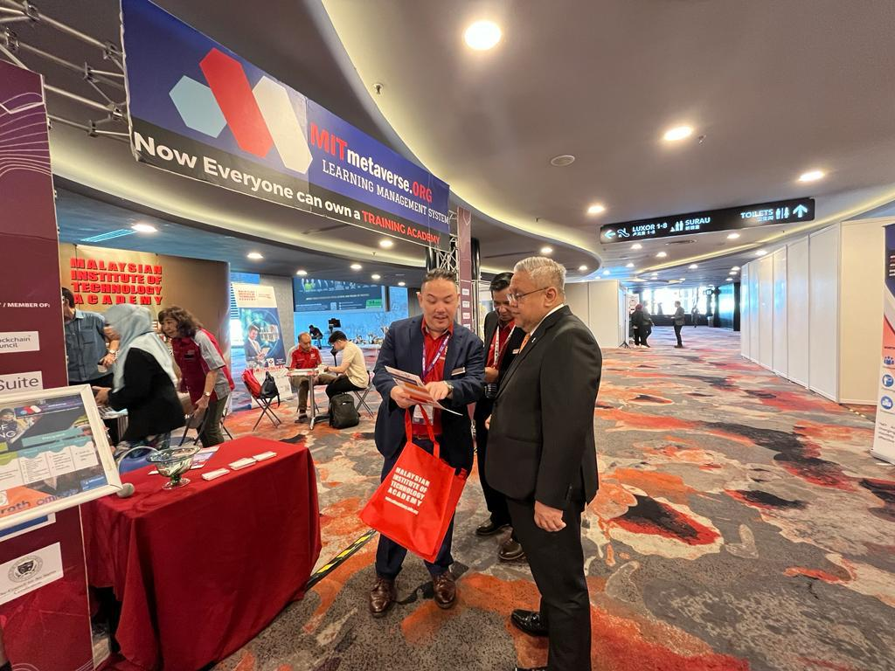
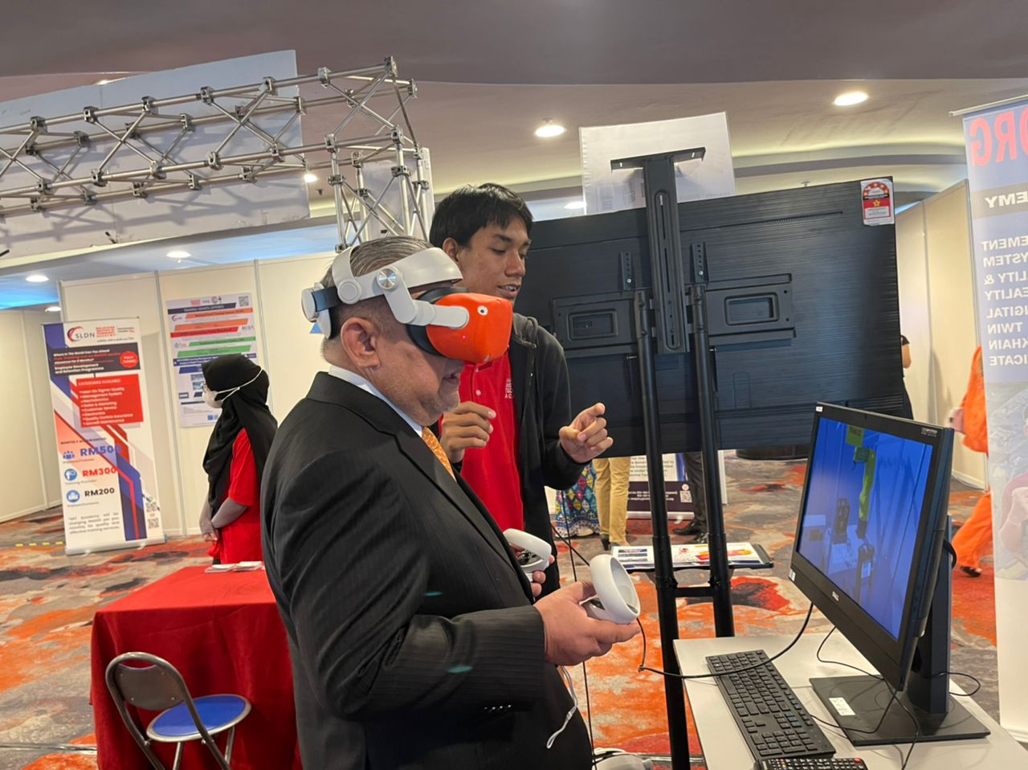
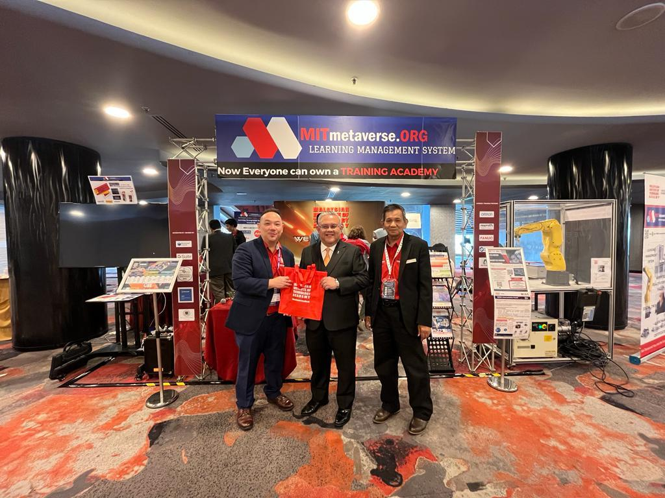
Formerly the Human
Resources GM of Jcorp
Inside the Metaverse in
MIT booth
Expressing our Genuine
Appreciation for Your Visit to
Our Booth

Slide 205
THANK YOU

